Slide 1
Enterprise Systems Renewal - FINANCE
Academic Fiscal Contacts
September 19, 2017

Slide 2
Agenda
Quick Introductions
Why ESR and why now?
ESR Program Approach Discussion
Project Approach
Staff Augmentation for Build and Change Management
Procurement Strategy – “Bake Off”
Program Roadmap and Structure
More on ESR…

Slide 3
Quick Introductions
Kal Kzsamboky, ITS Portfolio and Project Management Office
ESR Program Manager
Arlynn Renslow, Director, Control and Compliance
ESR Finance Change Lead
Ted Johnson, Chief Procurement Officer
ESR Procurement Strategy
Kevin Chou, Executive Director ITS
ESR Program Director

Slide 4
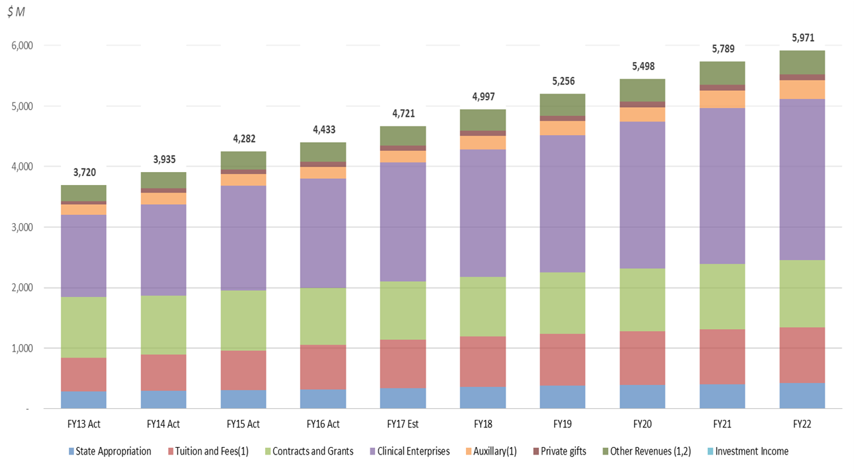
Why renew our enterprise systems and why now?
Our systems are no longer adequate in supporting our core business functions. Friction found in all domains of our current business processes makes existing processes difficult to scale to support our growing University.
While we have been able to absorb future increases in student enrollment and research activities with minimal to no growth in administration, we won’t be able do this for the next 10 years without process and system improvements.
Projected overall revenue growth of 5% exceeds inflation by 2%

Slide 5
ESR Program APPROACH discussion

Slide 6




Our iterative and incremental methodology
We are here!
Observe/discover the present state UCSD processes to accomplish its mission
Orient the findings based on the value of impact to the organization and the evolving culture
Decide on processes and underlying technology that will be renewed and the order in which they will occur
Act with precision to reengineer processes and deploy new technology to deliver desired outcomes
Deliverables: Inventory of processes, applications and data hierarchies.
Deliverables: Identification and validation of process friction, scope of impact and strategic alignment.
Deliverables: List of targeted initiatives, timeline and budgetary costs for renewal.
Deliverables: Plan, define, select, build, test and deploy targeted solutions.

Slide 7
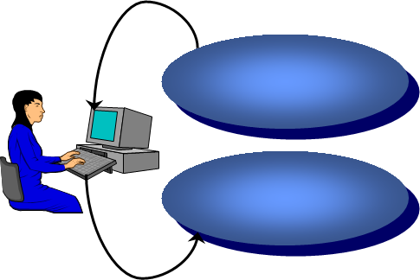
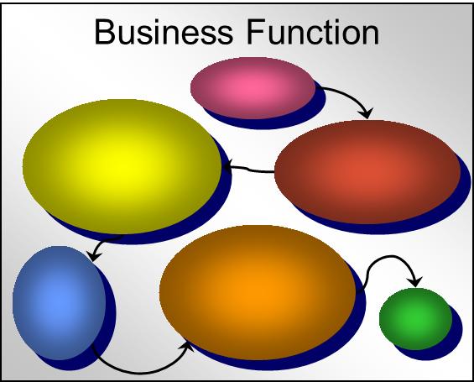
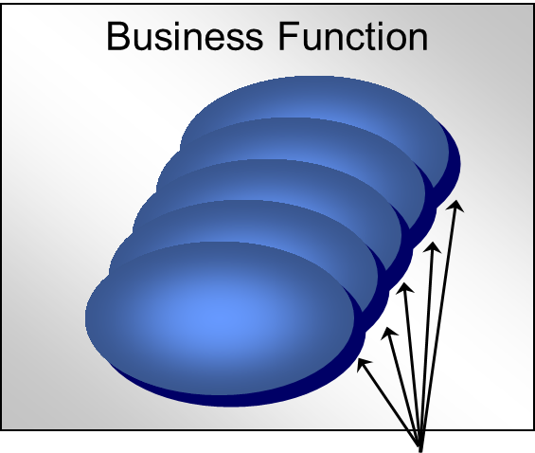
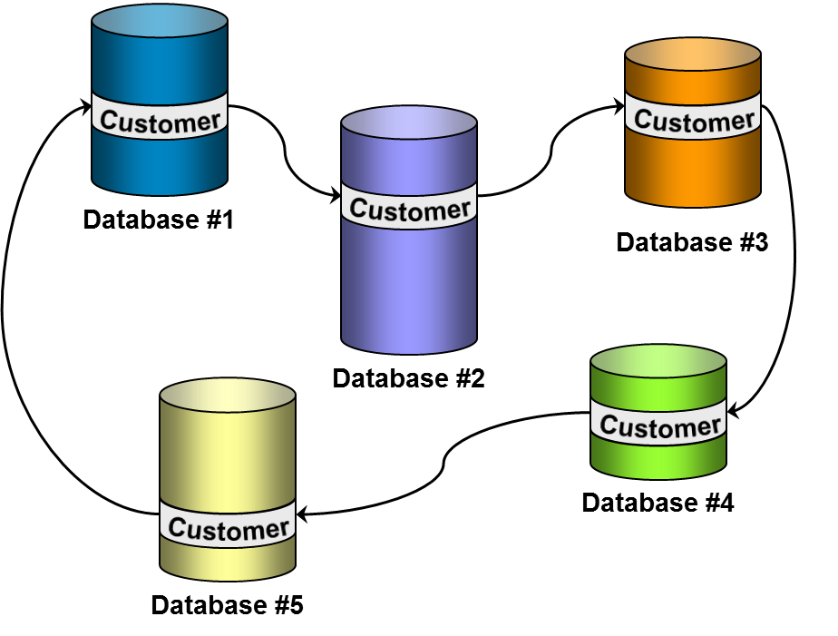
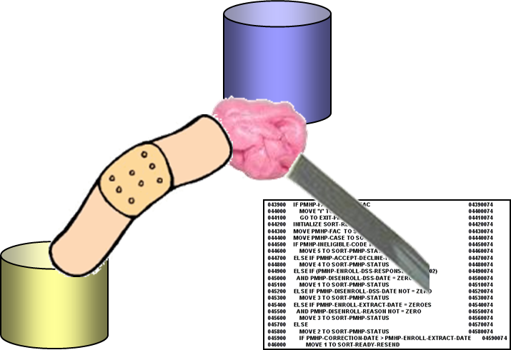

What are some examples of friction?
Manually re-keying or processing data
Use many different applications to fulfill responsibilities
Multiple applications with similar purposes and overlapping capabilities
Working with redundant copies of data.
Using kludges and work-arounds to get the job done.
Technology at work is less capable than you have a home.

Slide 8
Project Approach
Inventory and analysis of current business processes, friction, strategic alignment – across 4 major domains (Finance, Human Resources, Student and Research Administration)
Project decomposition into a) modules, b) processes/activities and c) data integration points
A new approach to software procurement – “Bake Off”
Iterative Execution:
  Evaluate each process for “lean-ness”, leverage Lean Six Sigma community of practice
  Build leaders, supported by process SMEs, oversee the design and configuration of the new system
  IT teams integrate data as required
  TEST!
  Change leaders, supported by a network of change agents, prepare people for change, coordinate training, communication, and escalate/de-escalate organizational issues
  Governance aggressively manage scope to avoid over-procurement and over-customization.

Slide 9
Staff Augmentation for Build and Change Management
Build Cycle; the onboarding of processes into a new system
  To enable this, managers should review the current workload on SMEs and push activities downward, creating overloads, succession plans and staff augmentation
    What work is being done to support backfill at the lowest level possible?
    How was the amount of work measured and how do we know the timing is right?
  Allocate all discretionary technical resources to the project and augment as needed
Change Cycle; helping people prepare for changes
  To enable this, managers should review the workload on designated change leaders and push activities downward, creating overloads and staff augmentation
ESR project team will help build and change leaders on 1, 2 above

Slide 10
What are possible challenges?
This is too complicated and there are too many moving pieces
There are lots of challenges, and they’re challenging
It’s going to takes a village but our people have day job
It’s too much change to deal with all at the same time
We can’t possibly do other projects while UC Path is going on
There’s no way to backfill for people with 25+ years of institutional knowledge
We’re unique, and will need lots of custom software to meet our special needs
Organizational change management, individual and group resistance, and all of the above
Staff turnover, retirements, burn out
Page 1 of ###

Slide 11
ESR Procurement Strategy – “bake off”

Slide 12




Traditional model
Preplanning and Project Implementation
2-6 months
Selection
.
4-6 weeks
3-4 weeks
Finalists Demo their solution’s capabilities and supplier is awarded based on demo and RFP responses.
Awarded supplier and Business explore systems capabilities and mapping to processes. Project implementation.
Document everything the current system does and processes surrounding current system. Requirements built based on current systems and processes.
RFP issued with scope and questions based on gathered requirements.

Slide 13

Project Implementation
Bake off model
Preplanning
Selection
6 Weeks
4-6 Weeks
4 Weeks
.
Finalists are given current business process to show actual implementation of system. Example of system capabilities and mapping to business scenario.
Awarded supplier and Business continue mapping system to processes and engage in project implementation.
Baseline requirements built using RFPs from universities with similar profiles. Combined with business processes and validated with stakeholders. 6 weeks
RFP issued with scope and questions based on consolidated requirements.
4 weeks

Slide 14
Traditional RFP
Process and Requirements documentation
RFP Issued
Supplier Demo's
Award
Financial System RFP - Bake Off Method
Award
Process and Requirements documentation
RFP Issued
Supplier Demo's
Month 1
Month 2
Month 3
Month 4
Month 5
Month 6
Month 7
Month 8

Slide 15
ESR PROGRAM ROADMAP and Structure

Slide 17
ESR PROGRAM STRUCTURE
IT Governance
Enterprise Information Services Committee (EISC)
Financial | Human Resources | Research | Student | Health (UCSD/UCI) | UCPath
Laurie Owen, AVC, Research
Daric Brummett, Executive Director, Advancement
Cathy Ledford, Chief HR Officer, Campus
Janet Kamerman, Chief HR Officer, Health
Cheryl Ross, AVC Controller
Mark Cunningham, AVC Housing Dining Hospitality
Juan Gonzalez, VC Student Affairs
Gene Hasegawa, COO Health Sciences
Bill Hodgekiss, Sr. AVC Academic Planning
Steve Gallagher, AVC Scripps Institution of Oceanography
Gary Matthews, VC RMP
Steve Ross, AVC Academic Resources
Adele Brumfield, AVC Enrollment Management
Lori Donaldson, CFO Medical Center
Kevin Chou, Executive Director ITS
Pierre Ouillet, VC CFO
ESR Program Team
Procurement
Ted Johnson, Chief Proc. Officer
Todd Adams, Director P&C
Linda Luna, Strategic Sourcing
Mary Chiu, RFx Coordinator
Architecture & Program Mgmt
Scott Lee, Enterprise Architect
David Hutches, Data Architect
Kal Zsamboky, ITS PMO
Kevin Chou
ESR Director
Change Facilitation
Steve Ross, AVC Academic Resources
Don Portugal, Director Medical Center Business Applications
Kevin Chou, ESR Director
Marketing, Communication & Training
Jessica Hilt, Marketing Lead
Elaine Fleming, Communications
Jade Griffin, UCPA
TBD, Training Coordination
ESR Work Streams
Change Lead
Build Lead
Technical Lead
Project Manager
ESR-Student/Academic
Cindy Palmer, AVC APS
Brandy Cheshire, APS Anlyst.
Jonathan Whitman, Dir. SIS
Sandra Titus, ITS
John Lane, ITS
ESR-Human Resources
TBD, Change Lead
TBD, Build Lead
Brian Lorentz, Assist. Dir. HRIS
Jude Poole, Dir. Biological Sciences IT
Rosemarie Del Mar, ITS
ESR-Finance
Arlynn Renslow, Dir. General Acc.
Adam Diprofio, Dir. Academic Fin.
Bill McCarroll, Sr. Dir. General Acc.
Bill Sweetman, Dir. FIS/HRIS
Kal Zsamboky, ITS (Interim)
ESR-Research
TBD, Change Lead
TBD, Build Lead
Sandon Jurowski, Assist. Dir. RIS
Susan Oswalt, ITS
ESR-UCPath
Pearl Trinidad, Exec. Dir. BFS
Jennifer Kramer, Assist. Dir. FIS
Beatrice Dormoy, ITS
ESR-Capital Asset Management
Vladimir Orlic, Asst. Dir. RMPIS
Kirk Belles, Space Management Anlyst.
Mary Ann Martel, Real Estate Anlyst.
Wendy Schiefer, Mgr. Fac. Mgmt.
Barry Peters, ITS
ESR-Analytics
Brett Pollak, Dir. Workplace Tech Services
Judy White, Assist. Dir. Bus. Intel.
Mara Cadagas, ITS
ESR-IT/Technical Change
Mojgan Amini, Dir. ITS Project Management and Continuous Improvement
ESR-HyperCare
Chris Rice, Experience Architect
Chris Ranglas, ITS
ESR-Integration Platform
TBD, Tech Lead
Dennis Fox, ITS
ESR-Identity/Access Management
Roger Phillips, Assist. Dir. ID/AM
TBD, ITS

Slide 18
Find out more @ esr.ucsd.edu
Soft Launch: September 18!

