Slide 1
Academic Affairs
Fiscal Contacts Meeting
May 16, 2017
Adam DiProfio
x22565

Slide 2
Today’s Topics
Benefits Decentralization
  Staffing List
Divisional Support Model Methodology

Slide 3
Decentralizing Benefits
Large Benefits budget held centrally by EVC
Division & Department level budget projections aren’t accurate without benefit allocations
Overall direction is to have allocations in departments at beginning of fiscal year
There is no way to determine which benefits on SOFI should be reimbursed

Slide 4
Decentralizing Benefits
Benefits will no longer be reimbursed based on fund source and program code
Benefits will be provided along with salary allocations
  Faculty (Sub 0 Staffing) - 35%
  Lecturers (Temp FTE) - 32%
  Staff (Div. Support Model or Sub 1 budget) - 45%
  TA (TA Allocation) - 2%

Slide 5
Decentralizing Benefits
5 Academic Divisions:
  Allocations to Divisions in April
  EVC’s Office working with Divisions to get allocations out to Departments
  Staff allocation based on Divisional Support Model
Other areas:
  Allocations made in April
  Staff allocation based on perm sub 1 budget

Slide 6
Next Steps
Work with Divisions to allocate sub 6 to departments
Allocate mid-year adjustments
Adjust in June to bridge projection to actuals
Correct Staffing List

Slide 7
Staffing List
5 Academic Divisions:
  Departments may convert permanent sub 3 or 8 to sub 1 without paying benefits
  Do not adjust permanent sub 6
Other areas:
  May create sub 1 using current process of paying into sub 6

Slide 8
Staffing List
Why the change for Academic Divisions?
  Merit increases built into Divisional Support Model
  Benefits allocated via Divisional Support Model
  Staffing List doesn’t affect department allocations
In the future permanent sub 1 could be adjusted to match Department allocation from Support Model

Slide 9
New Divisional Budget Workload Model
Concept
  Workload driven model
  Modular
  Fund reasonable levels of staffing and supplies
  Inputs come from Resource Profiles
  Adjust permanent budget annually as work goes up and down
  Allocation made to Divisions and they adjust allocations to Departments
Separated into 3 areas
  Core Operations
  Specialized Instructional Labs
  Research Support

Slide 10
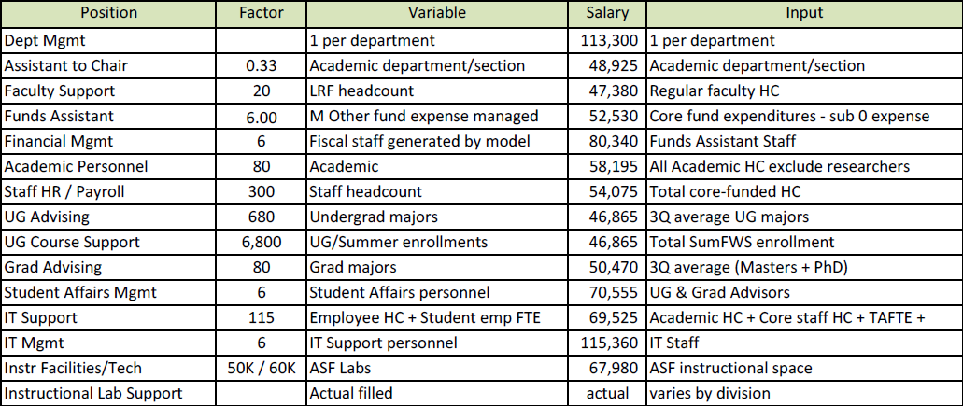
Core Support Staff Inputs

Slide 11
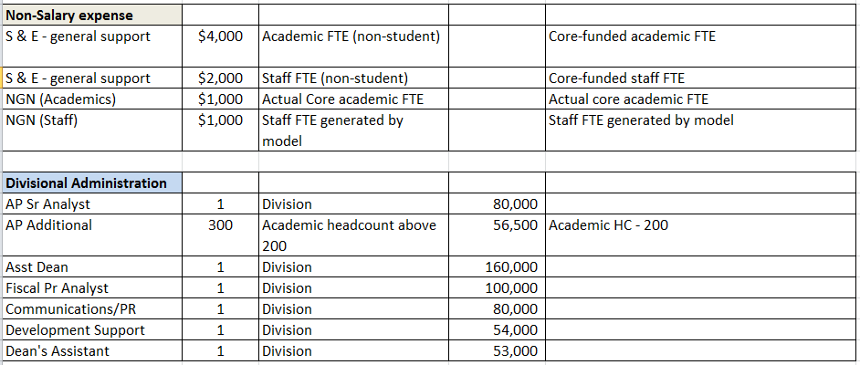
Inputs for Supplies & Dean’s Office

Slide 12
Instructional Labs & Research Support
Instructional Labs funded via historical Instructional Lab FTE & Instructional Lab S&E
Research Support – 7.5% of Direct Costs

