Slide 1
Policies and Procedures for MyEvents & MyTravel
Nancy Herbst
January 22, 2015

Slide 2
MyEvents

Slide 3
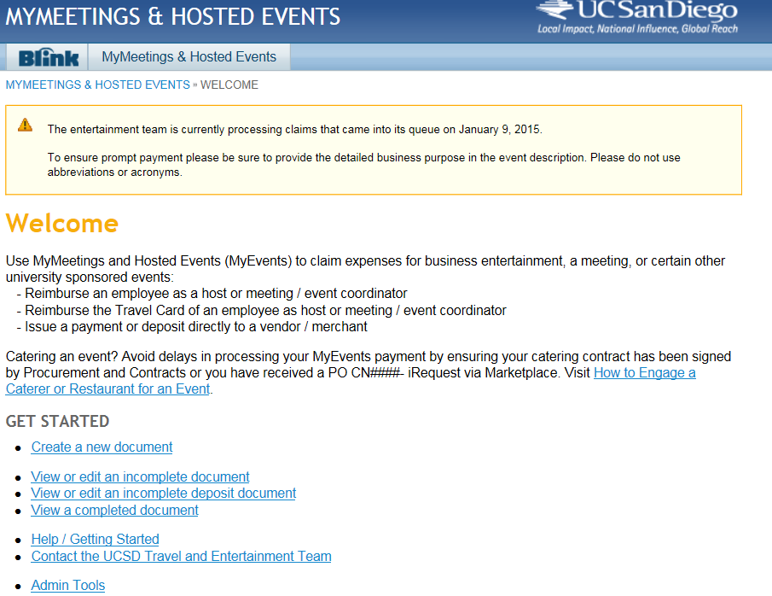
The MyEvent Process

Slide 4
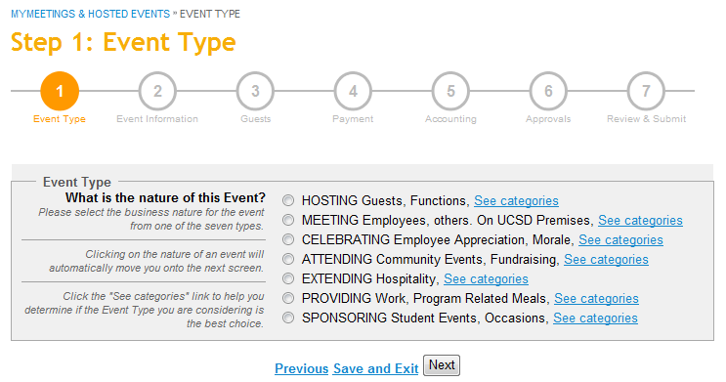

Event Type
Image
Goes Here

Slide 5
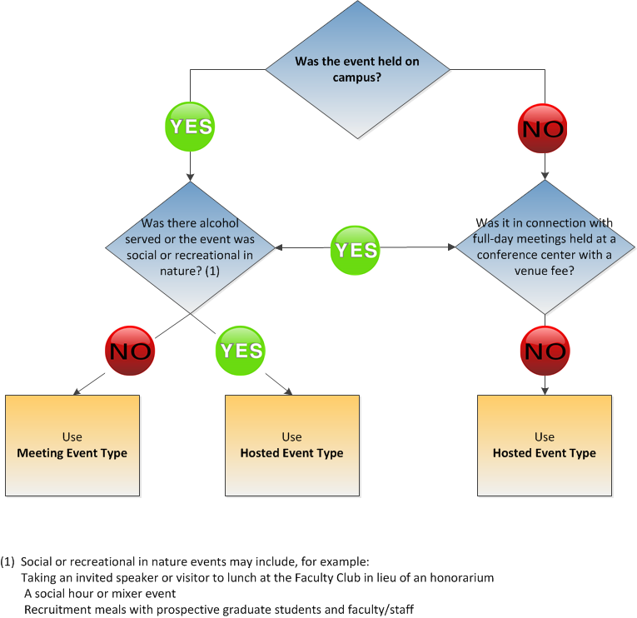
Event Type
Image
Goes Here

Slide 6
Event Type
Event Type | Examples
MEETING Employees, others. On UCSD Premises Administrative, planning, workgroups Planning, mentoring, workgroups (Faculty, Staff, UCSD students) Formal training sessions Professional association, scholarly society, external organization UC-wide meetings, Academic Senate, Regents *Meal over the CPP requires special entertainment approval | Grant project discussions Lab meeting Research collaboration within UCSD Mtg space like hotel conference room can be meeting (If alcohol is served, needs to be hosting)
HOSTING Guests, Functions • Donor, donor cultivation • Prospective academic or administrative appointee • Reception by invitation • Recruiting graduate student, student athlete, scholar • Visitor, official guest (person or organization) *Spouse/partner participation or over CPP requires special entertainment approval | Dinner to discuss donor prospects Dinner to discuss research and seminar Recruitment lunch Dinner with research group following a lecture Research collaboration with others outside of the University UCSD employees gathering off-site (at a restaurant or private residence) (Host needs to be present)
Image
Goes Here

Slide 7
The Event Type
Event Type | Examples
CELEBRATING Employee Appreciation, Morale • Appreciation, recognition, length of service • Employee morale group event, holiday party, picnic • Retirement, farewell *All require special entertainment approval | Welcome celebration to introduce new faculty member to support staff Lunch celebration of recruitment project completion Department holiday celebration
ATTENDING Community Events, Fundraising • Fundraising events (including purchase of tables) • Tickets to sporting, theatrical, musical event | Tickets to IMAX encourage std part in science & tech program SD Business Journal Women Who Mean Business Golf
EXTENDING Hospitality • Open house • Reception, open invitation to general public community • Visitor Spouse/partner participation or over the CPP requires special entertainment approval | Opening reception for an exhibition Department open house Library book club meeting La Jolla Del Sol apartments extending for community building events
mage
Goes Here

Slide 8
The Event Type
Event Type | Examples
PROVIDING Work, Program Related Meals • Employee on-the-job meals (no part list required) • Grand rounds (Medical Center) (no part list required) • Volunteers and research subjects (no part list required) | Educational conference Lunch provisions for research subjects Journal Club NOT for a meeting that is held during the lunch hour
SPONSORING Student Events, Occasions • Athletic team, training, game related (at home, no travel) • Continuing education, self-supporting programs • Gatherings, awards banquets, or meeting stds (only) (no part list required) • Orientation, commencement (no part list required) • Speaker – Student (637592) | Gathering for graduate students Quarterly social event/social hour Graduate students taking speaker out to discuss seminar. Tickets for zoo, boat excursions, field trip related activities for students remain on sponsoring, not attending.
Image
Goes Here

Slide 9
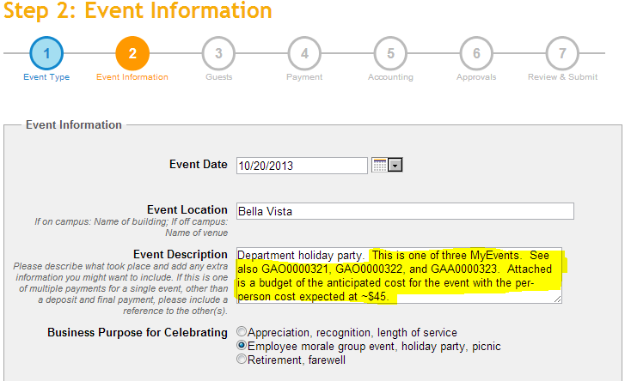
The Business Purpose
If more than one MyEvent is being processed for a single event, be sure to cross-reference the other event number(s).
When multiple MyEvents are required, also attach a ‘general’ budget so approvers can reasonably determine the anticipated per-person meal expense.
Please be careful with those acronyms!

Slide 10
The Business Purpose
Solid event description | Weak event description
Monthly fund manager meeting to discuss actuals against budget and year-end forecasting. | Monthly fund manager meeting
Hosted dinner with guest speaker to discuss student feedback and industry trends focused on the course. Or Hosted dinner with guest speaker prior to presentation to discuss logistics. Or Hosted dinner with guest speaker to discuss participant feedback to presentation. | Hosted dinner with guest speaker
Monthly Coleman lab meeting to discuss research findings from X and Y projects and to review Smith’s presentation. | Monthly Coleman lab
Image
Goes Here
Agenda may be attached to document business purpose

Slide 11
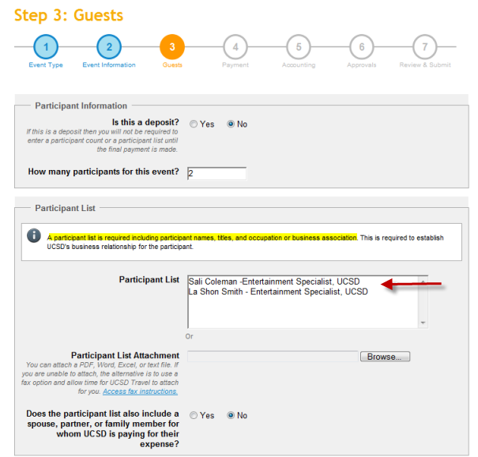
Describing the Participants
For multiple participants, you can upload a sign-in sheet, Excel file, etc.
REMINDER: Be sure to include the title and company affiliation.
Ex: Nancy Herbst, Travel Manager, UCSD
Research subjects can include first name and last initial
Ex: Nancy H, Research Subject

Slide 12
What Those Frequencies
UCSD does not reimburse employees for frequent or routine expenditures for meals or light refreshments as they're considered taxable income by the IRS
For meetings and entertainment events, limit:
Meals to once per month, per group
Light refreshments to twice per month, per group
While MyEvents asks the “frequency” question only for Meeting types, the limitations also apply to Hosted events.

Slide 13
The Business Purpose
Spouses in attendance
Donor activities
Recruiting – if the spouse of the candidate is in attendance
When the spouse works at UCSD
  Role is considered “employee” when attendance is that of an employee
Image
Goes Here
Exceeding the Per-Person Maximum Cost
The request must document the circumstances that were unavoidable or necessary to accomplish the University business purpose

Slide 14
Did you Know?
What is the per person maximum for light refreshments?
$18
What is the per person maximum for breakfast?
$26
What is the per person maximum for lunch?
$45
What is the per person maximum for dinner?
$78

Slide 15
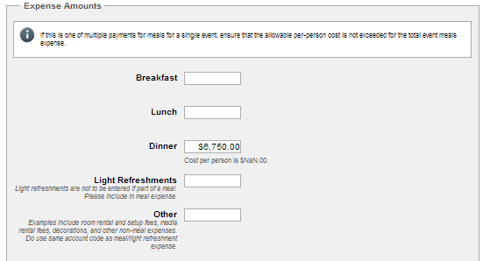
Per Person Meal Maximums
Remember those per-person meal maximums!
You must provide a written justification if expenses exceed the per-person meal maximum, including reasons why the higher costs were unavoidable and necessary to achieve a business purpose.
If it exceeds 200% over the limit, the event must be approved by the Chancellor.
The per-person meal expense is for the entire event:
  Includes pre-meal items (e.g., beverages and hors d-oeuvres), meal, labor, sales tax, delivery charges, and other service fees)
  Does not include room rental, setup fees, media rental fees, decorations, and other non-meal expenses (list these under “Other”).

Slide 16
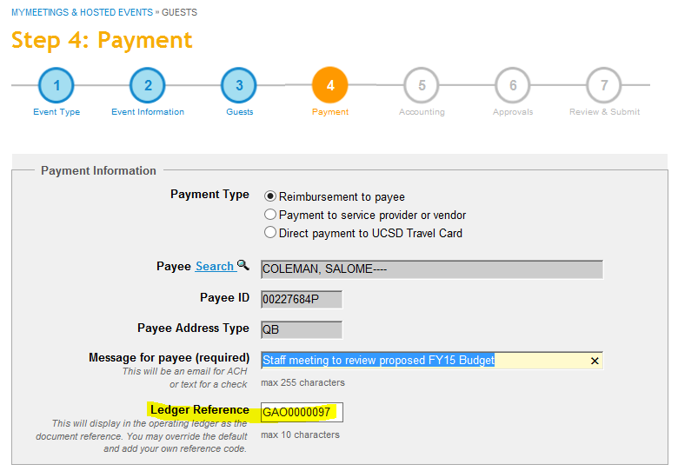
Choosing a Payment Option
The system will auto populate Host’s name.
If vendor, select Business/Entity in the payee search field.
Indicate the invoice number if paying a vendor.

Slide 17
Special Entertainment Extras
But remember….
Faculty and staff morale-boosting functions, such as appreciation, recognition, length of service, retirement, farewell, picnics or holiday gatherings, must serve a UC San Diego business purpose and can be approved as special entertainment if costs are:
Limited to only the employees in attendance
Permitted under the fund source
And the event should be….
Cost effective
In accordance with the proper use of public funds
Directly associated with the conduct of official UC San Diego business
In service of a clear UC San Diego business purpose with no personal benefit derived by either the official host or attending employees

Slide 18
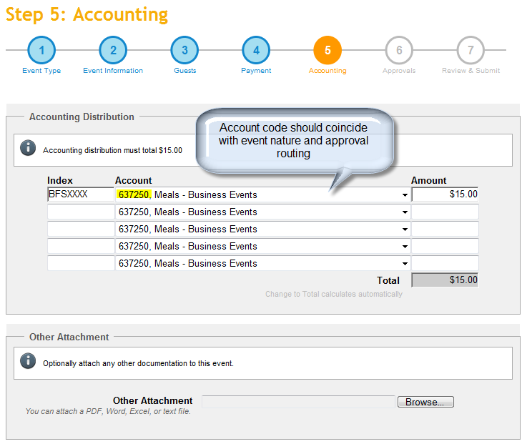
Account Code Options

Slide 19
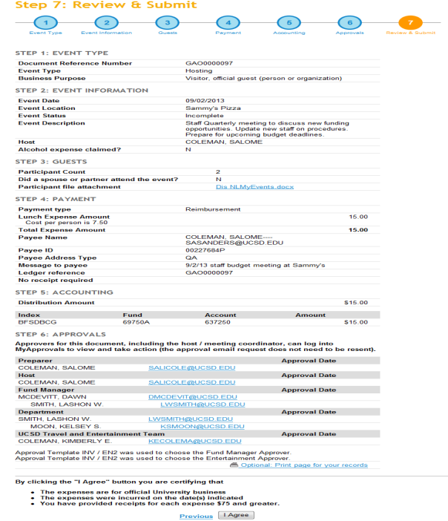
The Final Product

Slide 20
Special Considerations
Hosting at a private residence
Consider the amount of personal risk the host will need to accept
Invitation needs to reflect that UCSD is hosting the event
Follow IRS policy when making payment for services to individuals such as servers or cooks.
Remember that payment for these services is considered income to the recipient and must be reported to the IRS for tax purposes.
Collect names and Social Security numbers of recipients of payments for personal services.
Contact Jon Schmidt, Director of Risk Management (x43782) or by email to learn about potential risk and ways in which to minimize it.

Slide 21
Special Considerations
Attending community events and fundraisers
Documentation must breakout the “meal” from the “donation”
If the individual pays directly, then s/he can only be reimbursed the amount of the “meal”
If paying by Travel Card, the payment must be sent with the transmittal memo and the receipt should reflect UCSD as the payee
  Reimbursements to the Travel Card through MyTravel must include the transmittal letter and receipt (if available)
If paying by check, the transmittal letter must be uploaded in MyEvents
Image
Goes Here

Slide 22
Special Considerations
Receipts
Expenses of $75 or more must be supported by ‘original’ itemized receipt
If the expense being claimed exceeds $75 but is comprised of two receipts, each less than $75, the receipts are required
Lost receipts need to include a description of what steps the host/department did to obtain a duplicate receipt and what is being done to avoid future lost receipts
If a credit card statement is being submitted when the receipt is lost, redact the credit card number, home address, and personal purchases
Image
Goes Here

Slide 23
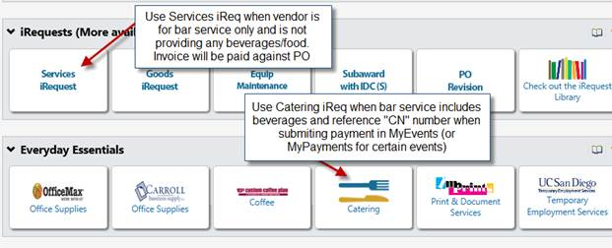
Catering
Catering Contracts
Don’t forget that catering vendors must have a contract signed by Procurement and Contracts or a PO CN# prior to the event and prior to submitting them through MyEvents for payment/ deposit.
Image
Goes Here

Slide 24
Updates

Slide 25
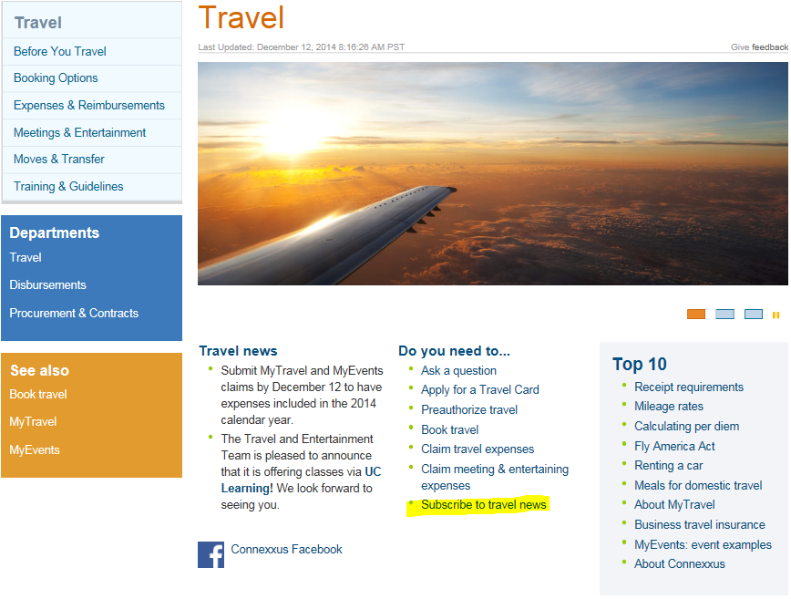
Updates
Image
Goes Here

Slide 26
Updates
 | Current Policy | Policy effective 1/1/15
Meetings and Entertainment | If using a UC San Diego Travel Card, it is recommended that expense reimbursements be submitted within 10 days of the event to ensure timely payment to US Bank. If personal payment was used, it is recommended that expense reimbursements be submitted within 21 days to reduce any financial burden on the employee. Expenses should be submitted within 60 days. Expenses submitted after 60 days but before six months should include an explanation as to why the event was not submitted within six months. | If using a UC San Diego Travel Card, it is recommended that expense reimbursements be submitted within 10 days of the event to ensure timely payment to US Bank. If personal payment was used, it is recommended that expense reimburse­ments be submitted within 21 days to reduce any financial burden on the employee. Final reporting of expenses must be submitted via MyEvents within 45 days of the event. Final reporting of expenses submitted via MyEvents after 45 days may be treated as taxable and reported on the employee’s W-2. (Employees should consult with their tax professional as to whether the expense can be deducted on their individual tax return.)

Slide 27
Updates
What we are doing to assist with the reduced time to submit expenses?
Hosts will receive a reminder email to approve the event every eight days until the event is approved. (Currently, only one email is sent to the host with no reminders.)
Electronic approvals will be requested simultaneously instead of sequentially (moving from host, to fund manager, to entertainment approver, etc.).

Slide 28
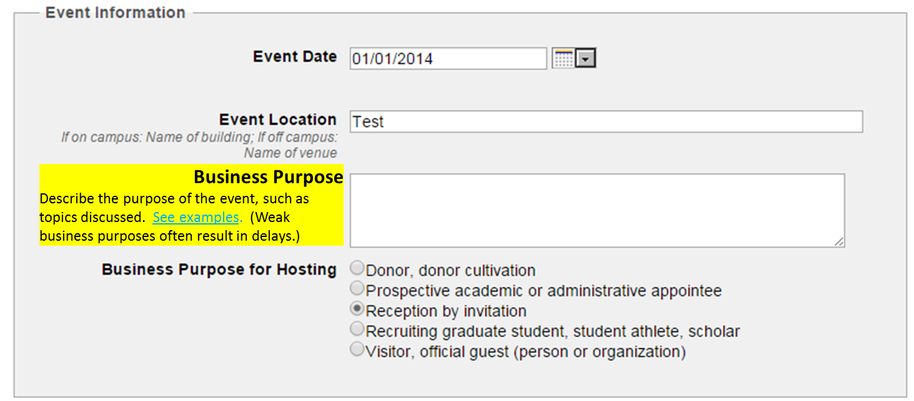
Updates
What we are doing to assist with the reduced time to submit expenses?
3. “Event Description” will be reworded with “Business Purpose” and a link providing examples of strong and weak descriptions will be provided.

Slide 29
Updates
What we are doing to assist with the reduced time to submit expenses?
4. Ability to track error rates by department to offer customized training.

Slide 30
Did you know?
We process approximately 24,000 events a year.
That’s almost 500 events a week!
And our team is comprised of 2 Entertainment Specialists
  Sali Coleman
  La Shon Smith

Slide 31


Slide 32
MyTravel

Slide 33
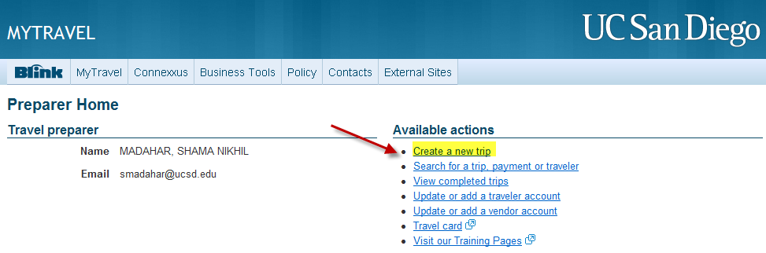
THE TRIP PREAUTHORIZATION PROCESS
From your MyTravel homepage, click on ‘Create a new trip’
Click on ‘Search for Traveler’ and, using the traveler ID, look up your traveler

Slide 34
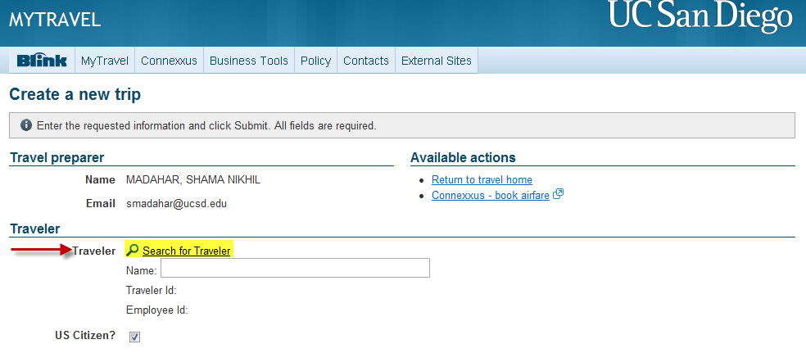
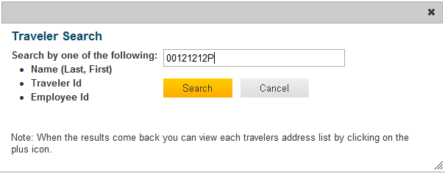
THE TRIP PREAUTHORIZATION PROCESS

Slide 35
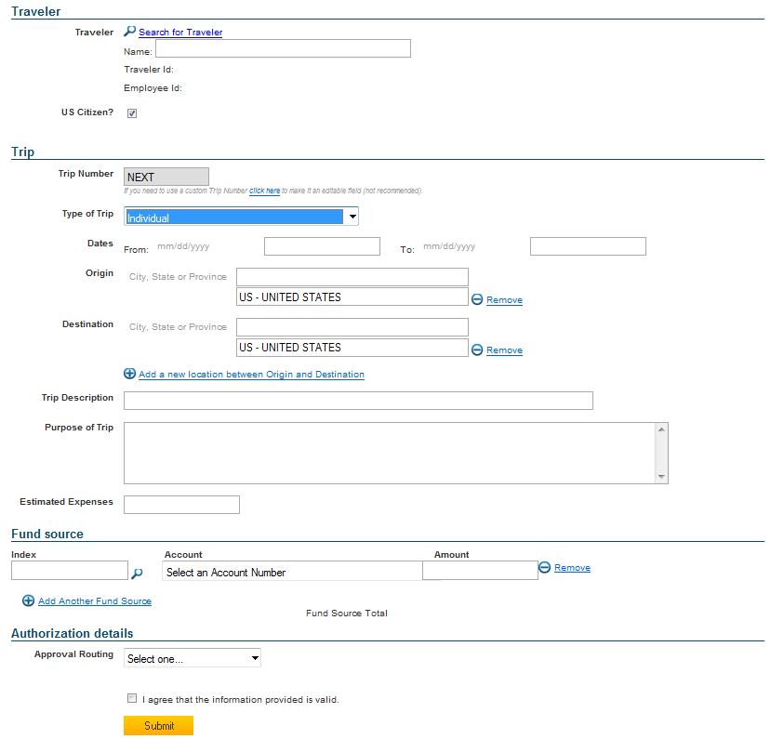
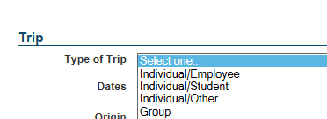
THE TRIP PREAUTHORIZATION PROCESS
Type of Trip
Individual – 1 traveler
Group – 3 or more travelers, outbound on a trip
Move/House-hunt/Temporary Housing – For moves and house-hunting trips
Recruitment – Candidates coming to UCSD for interviews

Slide 36
DESCRIBING THE PURPOSE
A business purpose should be clear to approvers familiar with the event as well as someone reviewing it who is not familiar with the event would have no questions as to the circumstances under which the travel occurred. It should be clear that it was necessary, reasonable, and primarily benefited UC San Diego.

Slide 37
DESCRIBING THE PURPOSE
Have the purpose of the trip include a description that makes it clear for the traveler type. For example, why is a non-employee attending a conference?
Agenda or other supporting documentation (conference brochure, invitation letter, etc.) should also be attached in support of the business purpose.
Solid Purpose | Weak description
Individual/Other: Attend the ABC Conference as subcontractor under UCSD XYZ grant. | Attend conference
Individual/Other: Presenter at UCSD’s ABC Conference | Attend conference

Slide 38
RECRUITMENT – SPOUSE TRAVEL
Can a spouse/partner’s travel be reimbursed when joining a recruitee for an interview?
Yes and No
Spouse’s travel may be reimbursed for the final interview only
Special approval by the vice chancellor is required for a spouse to accompany a candidate for faculty or high-level administrative positions (including Manager and Senior Professional positions) on final interviews
This approval may be in the form of a letter or email that is to be uploaded to MyTravel
Children accompanying a candidate may be reimbursed but will be treated as taxable (VC approval required)
Notes:
For Recruitment Travel

Slide 39

THE TRIP PREAUTHORIZATION PROCESS
Approval Routing
Pick an approval routing template created for you by your DSA

Slide 40
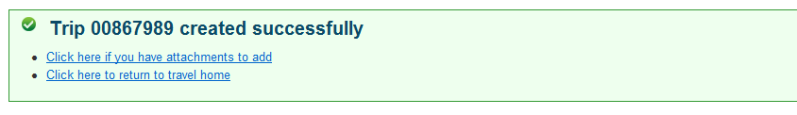
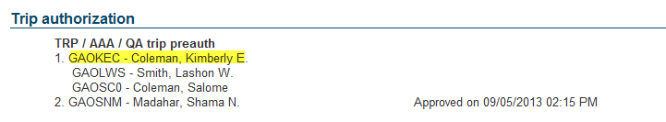
THE TRIP PREAUTHORIZATION PROCESS
Hit Submit and you see a message with the trip number
The trip is now in your dept. approver’s MyApprovals queue, pending pre-authorization
Click on ‘View Audit Trail’ for the trip from your homepage to see the trip’s routing

Slide 41
THE TRIP PREAUTHORIZATION PROCESS
After your dept. approver pre-authorizes the trip, the trip status will change to ‘pending completion’ and you will have a ‘claim expenses’ option under the Actions column
Use this option, after the completion of the trip, to reimburse the traveler

Slide 42
PROCESSING PREPAYMENTS
From your MyTravel homepage, select ‘Create prepayment’ for your traveler’s trip
Select the payment type
Complete all of the fields, select an approval routing template, and hit submit

Slide 43
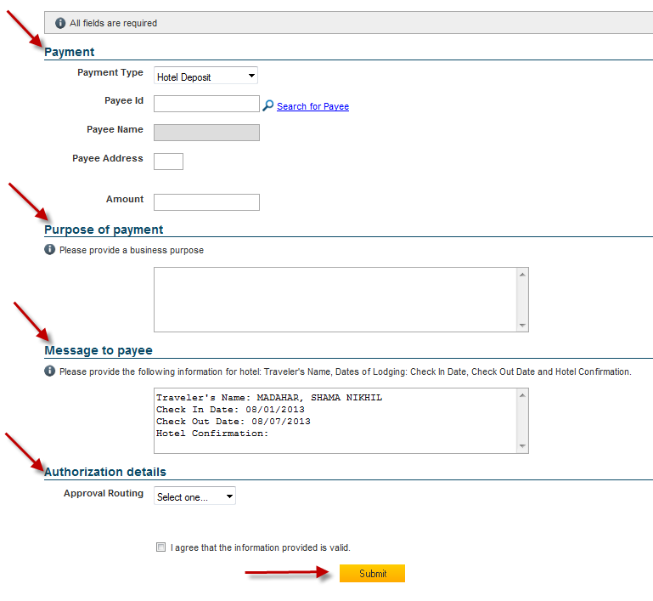
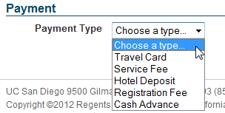
PROCESSING PREPAYMENTS
Payment type
Travel Card: used to prepay your travel card
Service Fee: used to prepay taxi, shuttle, buses
Hotel Deposit: used to prepay hotel
Registration Fee: used to prepay conference registration
Cash Advance: used for meals and ground transportation only (remote locations)
Notes:
Service Fees include ground transportation and shows in the “air” tab for reconciliaiton

Slide 44
PROCESSING PREPAYMENTS
What is the prepayment type you would choose for car service?
Service Fee
Prepayment will show up under “Air” tab when reconciling.
Include notes that the amount was for prepaid car service.
Requires a receipt!
  Upcoming enhancement will offer a ground option
Notes:
For Recruitment Travel

Slide 45
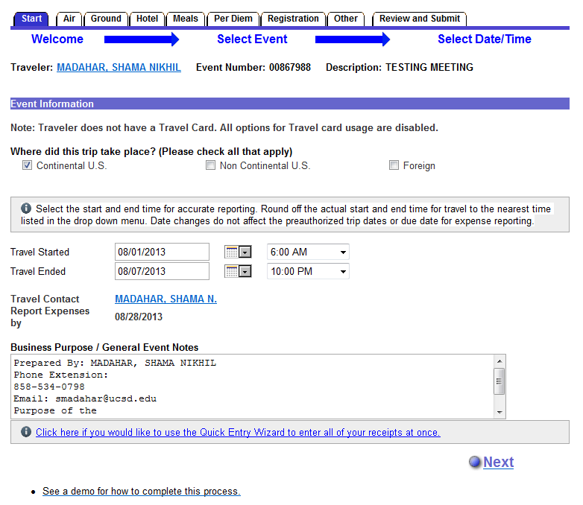
CLAIMING EXPENSES
After the completion of the trip, click on ‘claim expenses’ to reimburse the traveler
The first tab is the ‘Start’ tab – fill out the trip details here

Slide 46
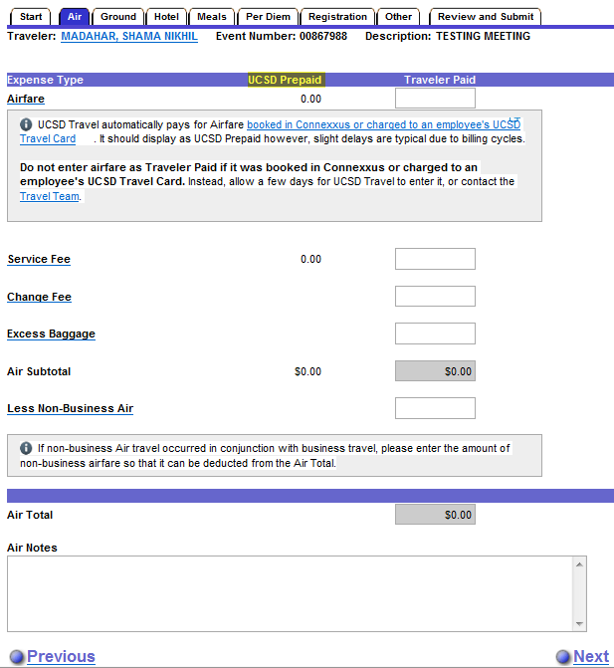
CLAIMING EXPENSES - AIR
Do not enter any UCSD prepaid airfare amounts. They will show under ‘UCSD Prepaid’ and in the total of airfare

Slide 47
EXPENSES – “MOST ECONOMICAL”
Early Bird Check-Ins
Needs to have a business purpose
  Not being around a computer at the 24-hour mark does not qualify
  Example: There are 30-minutes between flights and a need to debark a plane quickly to catch connecting flight
Medical certifications may not qualify for early bird check-ins when the airline will accommodate pre-boarding needs
  Height/size does not qualify for the need for special seat assignment (personal preference) unless there is a medical condition and certification.
Seat assignment fees are treated as early bird check-ins

Slide 48
EXPENSES – “MOST ECONOMICAL”
Using Private Vehicle instead of most economical options (flight)
Total cost of surface transportation cannot exceed the equivalent lowest cost airfare plus local transportation to and from terminals. Total cost of surface transportation may include:
  Meal or lodging, if a minimum of 300 miles per day are traveled by the most direct route
  Parking, tolls, taxis and/or ferries

Slide 49
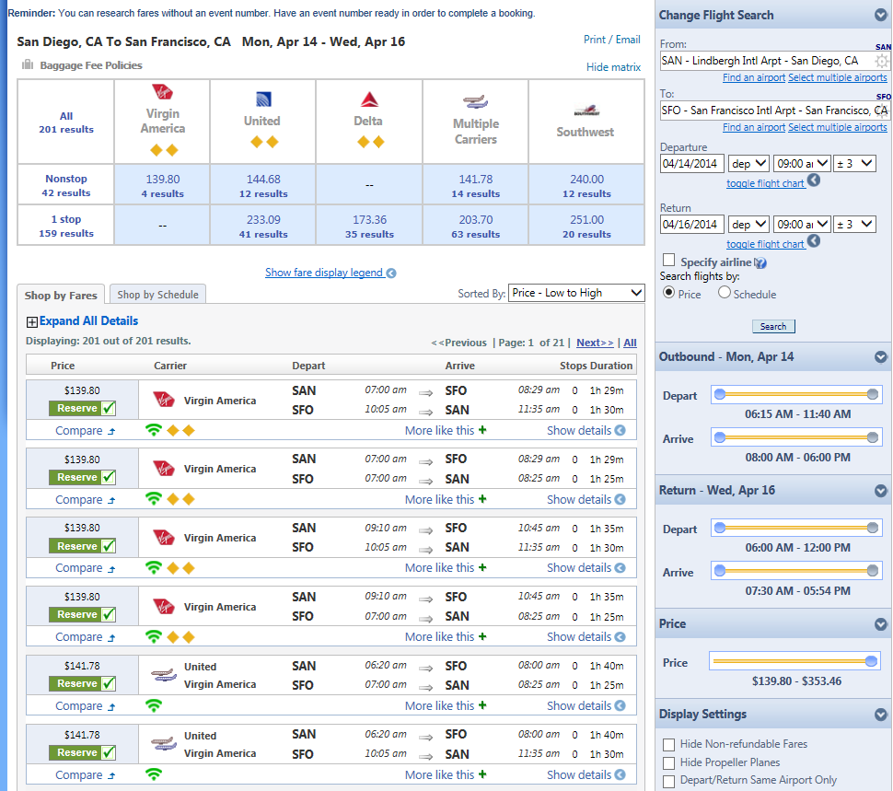
EXPENSES – “MOST ECONOMICAL”
Comparable Flights
Needs to be obtained at the time the original option chosen
Should include several examples
  Example: Claim that it is cheaper to fly into LAX and use a private car to San Diego instead of flying into San Diego.
  Example: Decision to drive to San Francisco instead of flying
Cannot be a “fully refundable” ticket

Slide 50
MEDICAL CERTIFICATIONS
UCSD is committed to providing services to assist faculty or staff members who become unable to perform assigned duties of their position because of a disability
Medical certification is valid for one year
The medical certification should not include the medical diagnosis of the traveler
Should include the type of work restrictions
Travel assumes that the department and the traveler have undergone the job accommodation interactive process and the requested travel accommodations have been determined to be reasonable

Slide 51
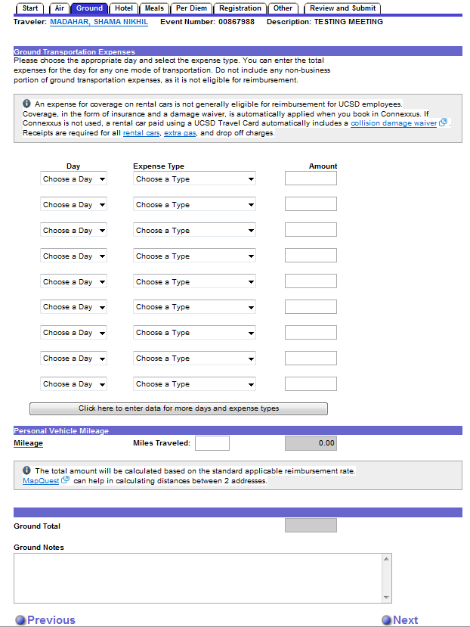
CLAIMING EXPENSES – GROUND
Use the drop down menus to pick day and type of ground expense(s)
If claiming mileage, enter miles towards the bottom of the page. The system will calculate the amount based on the current mileage rate
Notes:
Mileage Log attached and

Slide 52
MILEAGE
 | 2013 | 2014 | 2015
Mileage, general | 56.5¢ | 56¢ | 57.5¢
Mileage for moves | 24¢ | 23.5¢ | 23¢
MyTravel will automatically apply the new rates based on trip start date. Accordingly, mileage reimbursements that cover multiple years should be broken out into separate MyTravel claims.
The Mileage Reimbursement Rates page and Sample Mileage Log in Blink has been updated to reflect the changes with separate worksheets for each year.
Remember: Each leg of the trip must include a business purpose, including, for example, topics discussed.

Slide 53
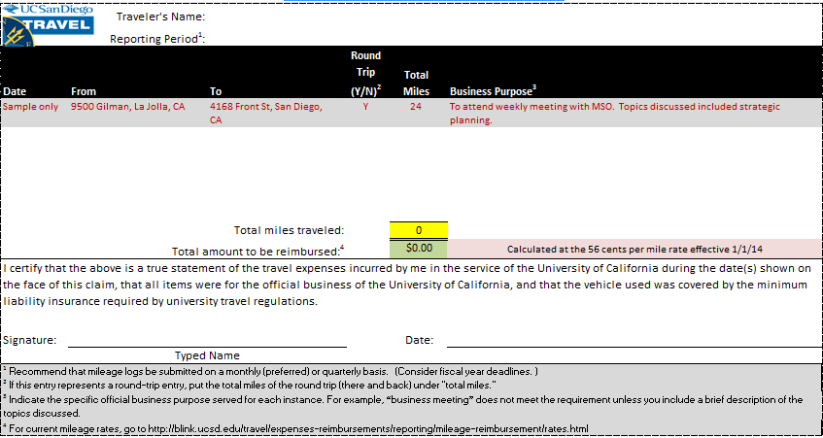
SAMPLE MILEAGE LOG

Slide 54

EXPENSES – “MOST ECONOMICAL”
Private cars
The purpose for a private car (limo) needs to address why other, more economical options, were not used
  Car rental
  Shuttle service
If used for a full day(s), provide an agenda reflecting the traveler’s schedule and need for such transportation

Slide 55
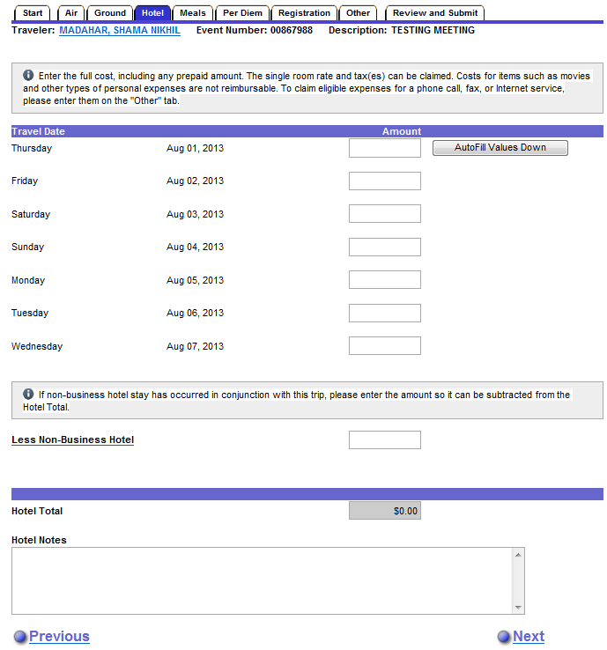
CLAIMING EXPENSES – HOTEL
Enter the nightly rate (incl. tax) for each day (even if the hotel was prepaid)
Prepaid hotel amount will be reflected next to the ‘hotel total’ and at the ‘review and submit’ tab

Slide 56
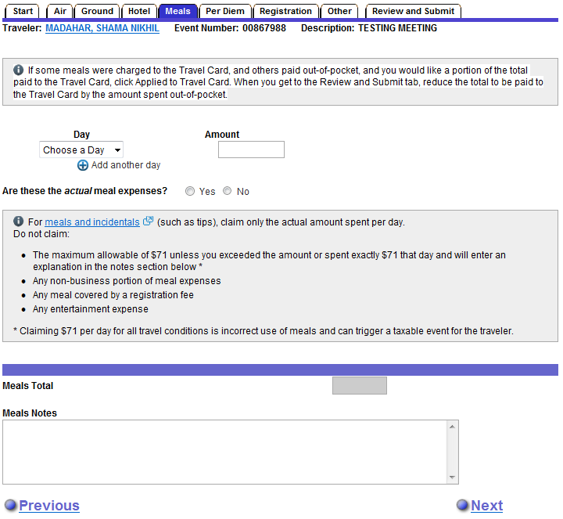
CLAIMING EXPENSES – MEALS
Use the drop down menu to pick day and enter the meals amount for that day

Slide 57
CLAIMING EXPENSES – MEALS
What is the maximum meals & incidental expenses (M&IE) per day?
(HINT: It was just on the previous slide. Did you see it?)
$71

Slide 58
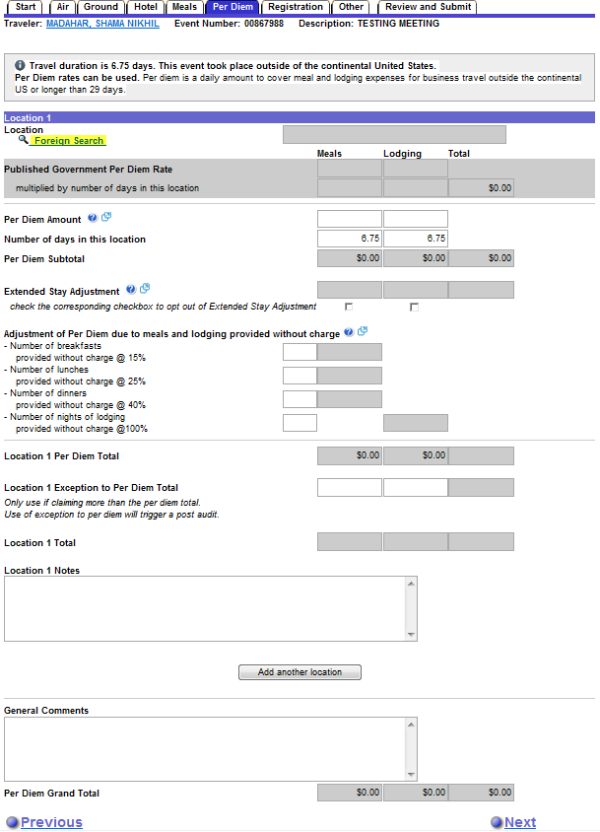
CLAIMING EXPENSES – PER DIEM
Hotel and Meals tabs are not available for such trips; use the ‘Per Diem’ Tab
Click on ‘Foreign Search’ to pick a location
Note: the ‘number of days in this location’ prepopulates with a number based on the dates and time of travel entered at the start page
Notes:
Encourage Travelers to claim actuals to save costs/reduce meals according to provision/ Exception to Per Diem

Slide 59
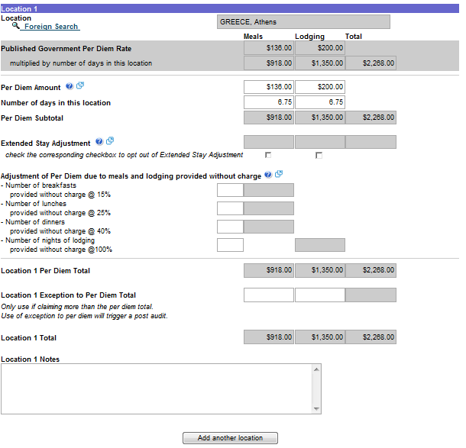
CLAIMING EXPENSES – PER DIEM
Selecting the city and country will prefill the amounts in the per diem tab for that location
Do not change anything if claiming 100% per diem
Must claim actuals if using federal funds
Adjust the per diem rate for meals and/or lodging if claiming actual expenses that are less than allotted per diem

Slide 60
CLAIMING EXPENSES – PER DIEM
If claiming more than per diem for lodging, what “extra” steps must you do? (Hint: There are two of them.)
1. Provide the business purpose as to why other “more economical” choices where not appropriate.
2. Attach receipts evidencing “actuals.”

Slide 61
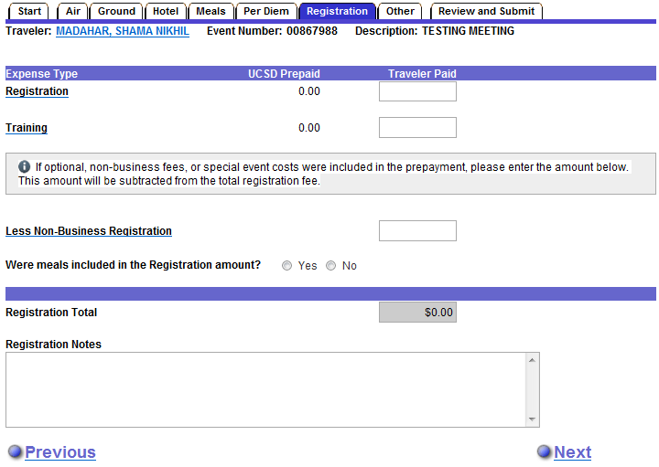
CLAIMING EXPENSES – REGISTRATION
Answer ‘Yes’ if you have registration expense to claim or ‘No’ to move to the next tab
Do not enter any UCSD prepaid registration amounts. They will show under ‘UCSD Prepaid’ and in the total of registration

Slide 62
CLAIMING EXPENSES – MEALS
If attending a local conference, can you claim meals?
No. Meal costs can be claimed only for travel longer than 24 hours and that required lodging.

Slide 63
LOCAL CONFERENCES
Use MyTravel for local conferences
Travel Card to be used for conferences
  Prepayments available if the traveler does not hold a travel card
An expense for lodging within the vicinity of your home or headquarters is generally not eligible for reimbursement unless an early start time is combined with a distance greater than 40 miles
IRS Taxable Fringe Benefit Guide specifically excludes meals unless the traveler is away from his or her home overnight as supported by a lodging receipt
Notes:
Additional requirement that applies to the overnight stay

Slide 64
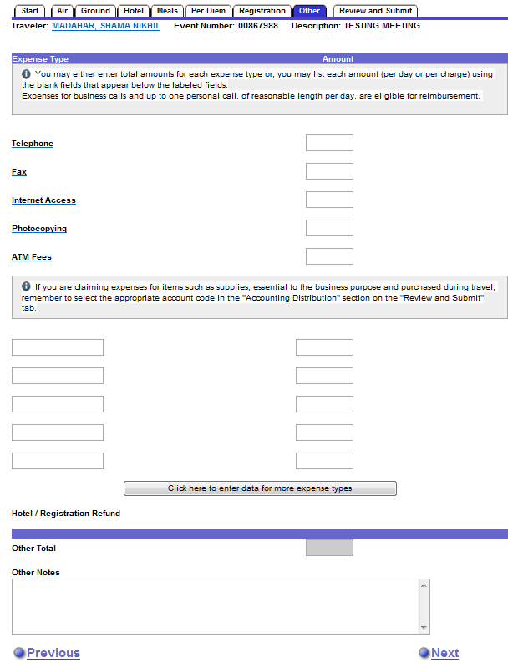
CLAIMING EXPENSES – OTHER
Use this tab to claim other expenses such as internet access, ATM fees, visa fees, etc.

Slide 65
MISCELLANEOUS
Laundering
Only available if trip exceeds six days
Currency Converters
Attached with receipts
Converted as of the day of purchase (ideal)

Slide 66
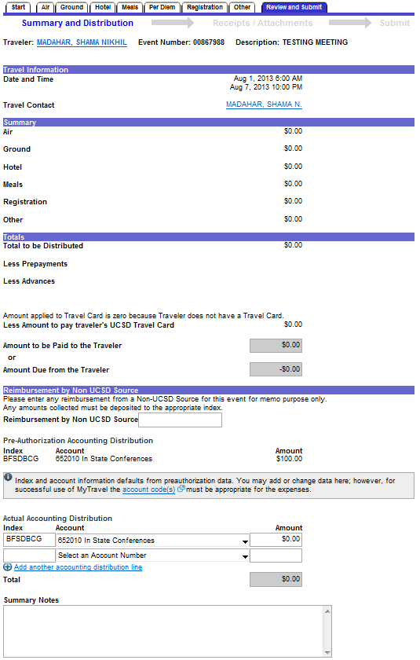
CLAIMING EXPENSES – REVIEW & SUBMIT
This is the total of all the expenses for this trip
Any prepayments and/or advances for the trip will be deducted here
List the amount to be paid directly to the traveler’s travel card here
This is the reimbursement amount to the traveler
Ensure the index(es) and amounts match the total amount for this trip
Use Summary notes for any explanation or additional information about the trip
Notes:
Refer to the view/edit to check all expenses.

Slide 67
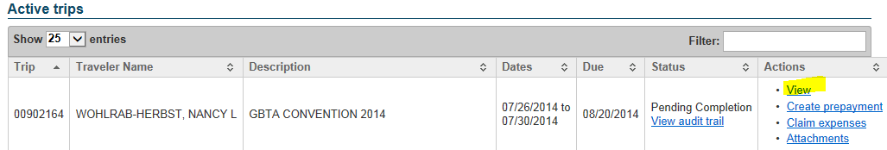
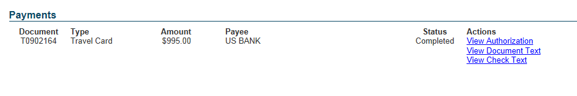
CLAIMING EXPENSES – REVIEW & SUBMIT
Need to see any prepayments or their status?
Notes:
Refer to the view/edit to check all expenses.

Slide 68
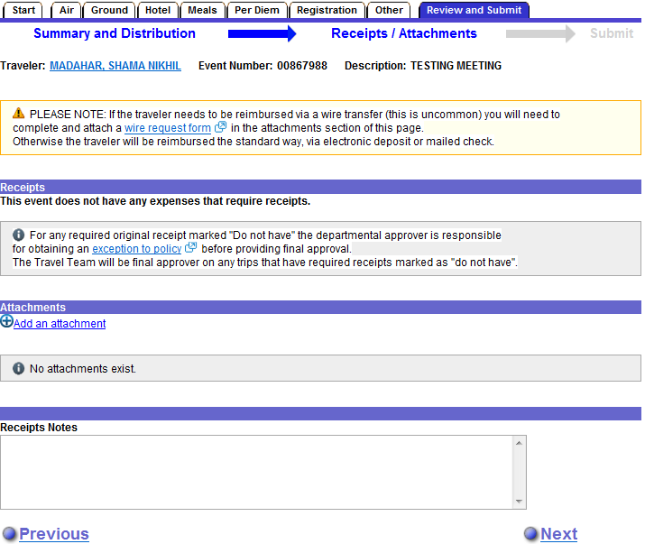
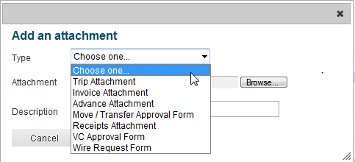
CLAIMING EXPENSES – REVIEW & SUBMIT
Click on ‘Add an attachment’
Use ‘Receipts Attachment’ type for all required receipts
Use ‘Wire Request Form’ type when attaching a wire form for reimbursement
Notes:
Select “Receipt” Type when a receipt is required

Slide 69
CLAIMING EXPENSES – REVIEW & SUBMIT
Notes:
Select “Receipt” Type when a receipt is required

Slide 70
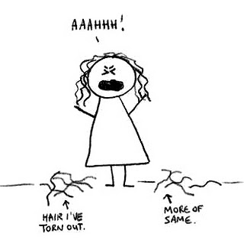
NEED A RECEIPT?
Argh! The system is telling me that I cannot submit because there are receipts missing – BUT THEY ARE ATTACHED!
Make sure at least one of your attachments are identified as a “receipt” and not just a “trip” attachment.

Slide 71
WHAT TO DO IF THERE IS A LOST RECEIPT?
Describe the steps the department/traveler has done to try to get duplicate receipt(s) from vendor(s)
What will the traveler/department do to avoid it from happening in the future
Redact credit card statements to remove account numbers, home addresses, and personal purchases
Stay away from those “package” deals!

Slide 72
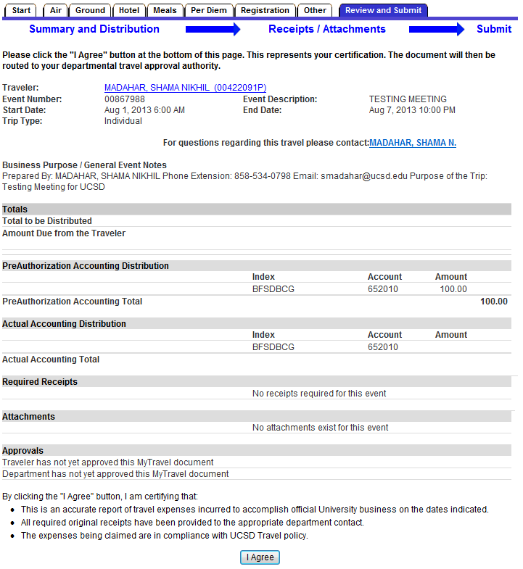
CLAIMING EXPENSES – REVIEW & SUBMIT
This page summarizes all of the expenses and charges to the index for this trip
Click on ‘I Agree’ to certify the trip as preparer
This will generate an email with a link to the traveler (employee only) requesting their certification
After the traveler certifies, an email will be generated to the dept. approver for final approval of this trip
Notes:
If the Totals is the only segment you see no expenses have been claimed.

Slide 73
APPROVAL PROCESS
Preparer submits
Traveler certifies if UCSD employee
Final Departmental Approver
If trip is considered “low risk,” trip will “self approve” after seven days
Travel Department
Not all trips are reviewed by the Travel Team

Slide 74
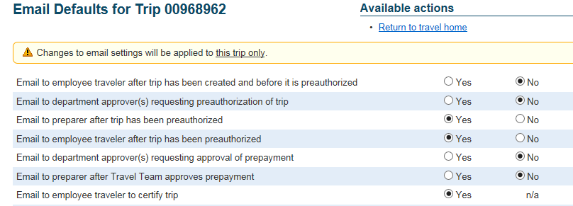
TRAVELER CERTIFICATION EMAILS
Yes, the email is the only way a UCSD Employee traveler can certify a trip.
No, the travel office cannot regenerate the email to the traveler for certification. But, a reminder email goes to the traveler every 8 days.
Also, preparer can go into the email defaults for the trip and resend the email.

Slide 75
APPROVAL CONSIDERATIONS
Benefits to UC San Diego | Ensure that the anticipated benefits outweigh the costs. You might explore alternatives that would be equally effective in accomplishing the desired objectives. (I.e., private car service versus car rental.)
Tax issues | The expenses are lavish or extravagant for the type of travel. The travel is not directly related to the employee's job or otherwise qualifies as a UC San Diego business expense.
This is why the “purpose” description is so important and why there has been some “refining” of procedures.

Slide 76
Enhancements!

Slide 77
ENHANCEMENTS
Canceling Trips (current)
  The preparer can cancel all trips as long as there are no prepayments requested or issued
Customizing Email Defaults (current)
  The preparer can set up default email settings for all future trips and may modify settings at the trip level
Mileage only claims (future)
  One step process – no longer need to preapprove and then process
Email reminders to reconcile trips (future)
  Email reminder option for traveler and preparer when the trip is 7 to 10 days past the reconciliation date

Slide 78
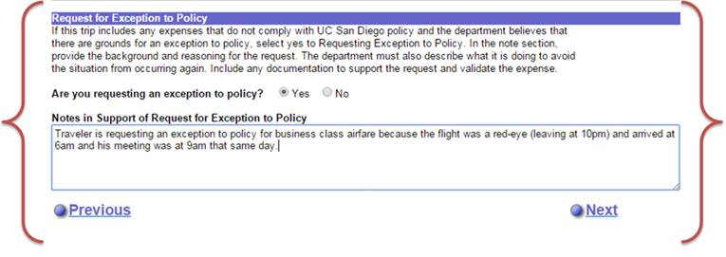
ENHANCEMENTS
Exceptions to Policy
The process for requesting approval of “Exception to Policy” has been simplified. The Department approver no longer needs to use the “Send for Review” to the Travel Team. This enhancement allows preparers to request approval of an exception to policy during the process of claiming expenses. The feature is found on the “Review and Submit” tab.

Slide 79

ENHANCEMENTS
Local hotels
  You may now book local hotels through Connexxus and they will be direct billed (same as with airfare).
  No need to request a prepayment check to be sent to the hotel
  No need to use a personal credit card to hold the room
  Negotiated rates

Slide 80
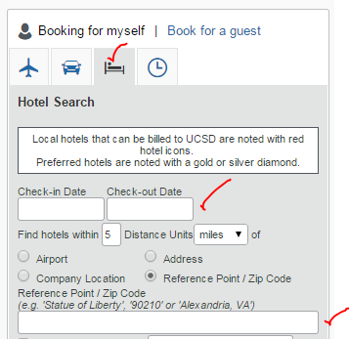
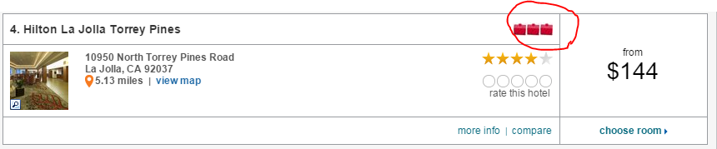
ENHANCEMENTS
Available Direct Bill Hotels:
Residence Inn San Diego La Jolla
Empress Hotel
Sheraton San Diego Mission Valley
Hilton La Jolla Torrey Pines
Hotel La Jolla
Sheraton La Jolla
San Diego Marriott La Jolla
Grande Colonial Hotel
Estancia La Jolla Hotel & Spa

Slide 81
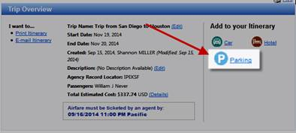
ENHANCEMENTS
Add Park N’ Fly to your itinerary
When booking online in Connexxus via Balboa Travel, you can now add Park N’ Fly to your reservation. Park N’ Fly offers UC San Diego employees parking at a discounted rate and waives the $3 service charge. Booking is easy, simply click the “Parking” link located on the Trip Overview page, select the desired parking option and pay using your Travel Card, or personal form of payment.

Slide 82
KEEP CURRENT ON POLICY CHANGES
 | Current Policy | Policy Effective 1/1/15
Travel | Expenses should be submitted within 21 days. If using a UC San Diego Travel Card, it is recommended that expense reimbursements be submitted within 10 days of the trip (or a prepayment to the Travel Card made prior to the trip end date) to ensure timely payment to US Bank. Expenses submitted after six months should include an explanation as to why the event was not timely submitted. | Expenses should be submitted within 21 days. If using a UC San Diego Travel Card, it is recommended that expense reimbursements be submitted within 10 days of the trip (or a prepayment to the Travel Card made prior to the trip end date) to ensure timely payment to US Bank. Final reporting of expenses must be submitted via MyTravel within 45 days of the trip’s completion. Final reporting of expenses submitted via MyTravel after 45 days may be treated as taxable and reported on the employee’s W-2 or traveler’s 1099. (Travelers should consult with their tax professional as to whether the expense can be deducted on their individual tax return.)

Slide 83
KEEP CURRENT ON POLICY CHANGES

