Slide 1
EVC Business Office
Transaction Preparers
Quarterly Training meeting
February 7, 2014

Slide 2
AGENDA
Welcome
Background & Goals
Introductions
MyTravel & MyEvents:
Best Practices & Updates
Express Card Attachment Tool
Q&As

Slide 3
MyTravel

Slide 4
Selecting the Trip Type
Type of Trip
Individual – 1 traveler
Group – 3 or more travelers, outbound on a trip
Move/House-hunt/Temporary Housing – For moves and house-hunting trips
Recruitment – Candidates coming to UCSD for interviews

Slide 5
Describing the Purpose
“Purpose of Trip” should include a description that clearly supports the “Type of Trip.” [for example, explain why a non-employee is attending a conference]
Solid Purpose | Weak description
Individual/Other: Attend the ABC Conference as subcontractor under UCSD XYZ grant. | Attend conference
Individual/Other: Presenter at UCSD’s ABC Conference | Attend conference

Slide 6
Medical Certifications
UCSD is committed to providing services to assist faculty or staff members who become unable to perform assigned duties of their position because of a disability
Medical certification is valid for one year
The medical certification should not include the medical diagnosis of the traveler
Should include the type of accommodation to be made
Travel assumes that the department and the traveler have undergone the job accommodation interactive process and the requested travel accommodations have been determined to be reasonable

Slide 7
Expenses – Lost Receipts
Describe the steps the department/traveler have done to try to get duplicate receipt(s) from vendor(s)
What will the traveler/department do to avoid it from happening in the future
Redact credit card statements to remove account numbers, home addresses, and personal purchases
Stay away from those “package” deals!

Slide 8
Expenses – “Most Economical”
Private Car Service
The purpose for a private car (limo) needs to address why other, more economical options, were not used
Car rental
Shuttle service
If used for a full day(s), provide an agenda reflecting the traveler’s schedule and need for such transportation

Slide 9
Expenses – “Most Economical”
Early Bird Check-Ins
Needs to have a business purpose
Not being around a computer at the 24-hour mark does not qualify
Example: There are 30-minutes between flights and a need to debark a plane quickly to catch connecting flight
Medical certifications may not qualify for early bird check-ins when the airline will accommodate pre-boarding needs

Slide 10
Expenses – “Most Economical”
Using Private Vehicle instead of most economical options (flight)
Total cost of surface transportation cannot exceed the equivalent lowest cost airfare plus local transportation to and from terminals. Total cost of surface transportation may include:
Meal or lodging, if a minimum of 300 miles per day are traveled by the most direct route
Parking, tolls, taxis and/or ferries

Slide 11
Expenses – “Most Economical”
Comparable Flights
Needs to be obtained at the time the original option chosen
Example: Claim that it is cheaper to fly into LAX and use a private car to San Diego instead of flying into San Diego.
Example: Decision to drive to San Francisco instead of flying
Long-Term Parking
Travelers should seek out the longer-term parking accommodations at airports or common carriers when travel is expected to exceed twenty-four hours

Slide 12
Expenses – Conferences
Use MyTravel for local conferences
Travel Card should be used for conferences
Prepayments available if the traveler does not hold a Travel Card
An expense for lodging within the vicinity of your home or headquarters is generally not eligible for reimbursement unless an early start time is combined with a distance greater than 40 miles
IRS Taxable Fringe Benefit Guide specifically excludes meals unless the traveler is away from his or her home overnight as supported by a lodging receipt

Slide 13
Expenses – Miscellaneous
Laundering
Only available if trip exceeds six days
Currency Converters
Attached with receipts
Converted as of the day of purchase

Slide 14
Incidental Expenses
What exactly is an “Incidental Expense?”
Incidental expenses are part of the per diem and Meals & Incidental Expenses (M&IE) and include tips for services and costs for ground transportation directly connected with a meal (e.g., taxi from hotel to restaurant and back). In MyTravel, cash tips given to hospitality staff, baggage handlers, etc., and transportation to and from meals, should be claimed as part of the M&IE /per diem and not claimed as an “Other” or “Ground Transportation” expense. Visit Per Diem for Travel and Meals for Short-Term Domestic Travel to learn more.

Slide 15
MyTravel – Training Modules

Slide 16
MyEvents

Slide 17
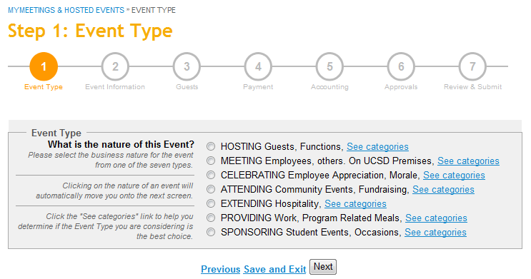
The Event Type

Slide 18
Event Type | Examples
MEETING Employees, others. On UCSD Premises Administrative, planning, workgroups Planning, mentoring, workgroups (Faculty, Staff, UCSD students) Formal training sessions Professional association, scholarly society, external organization UC-wide meetings, Academic Senate, Regents Meal over max requires special entertainment approval | Grant project discussions Lab meeting Research collaboration within UCSD Meeting space like hotel conference room can be meeting
HOSTING Guests, Functions Donor, donor cultivation Prospective academic or administrative appointee Reception by invitation Recruiting graduate student, student athlete, scholar Visitor, official guest (person or organization) Spouse/partner participation or over max requires special entertainment approval | Dinner to discuss donor prospects Dinner to discuss research and seminar Recruitment lunch Dinner with research group following a lecture Research collaboration with others outside of the University UCSD employees gathering off-site (at a restaurant or private residence)
CELEBRATING Employee Appreciation, Morale Appreciation, recognition, length of service Employee morale group event, holiday party, picnic Retirement, farewell All require special entertainment approval | Welcome celebration to introduce new faculty member to support staff Lunch celebration of recruitment project completion Department holiday celebration

Slide 19
Event Type | Examples
ATTENDING Community Events, Fundraising Fundraising events (including purchase of tables) Tickets to sporting, theatrical, musical event | Tickets to IMAX encourage std part in science & tech program SD Business Journal Women Who Mean Business Golf
EXTENDING Hospitality Open house Reception, open invitation to general public community Visitor Spouse/partner participation or over max requires special entertainment approval | Opening reception for an exhibition Department open house Library book club meeting La Jolla Del Sol apartments extending for community building events
PROVIDING Work, Program Related Meals Employee on-the-job meals (no part. list required) Grand rounds (Medical Center) (no part. list req’d) Volunteers and research subjects (no part. list req’d) | Educational conference Lunch provisions for research subjects Journal Club NOT for a meeting that is held during the lunch hour
SPONSORING Student Events, Occasions Athletic team, training, game related (at home, no travel) Continuing education, self-supporting programs Gatherings, awards banquets, or meeting students (only) (no part. list req’d) Orientation, commencement (no part. list req’d) Speaker – Student (637592) | Gathering for graduate students Quarterly social event/social hour Graduate students taking speaker out to discuss seminar. Tickets for zoo, boat excursions, field trip related activities for students remain on sponsoring, not attending.

Slide 20
Watch Those Frequencies
UCSD does not pay or reimburse frequent or routine expenditures for meals or light refreshments for employees as they're considered taxable income by the IRS
For meetings and entertainment events, limit:
Meals to once per month, per group
Light refreshments to twice per month, per group
While MyEvents asks the “frequency” question only for Meeting types, the limitations also apply to Hosted events.

Slide 21
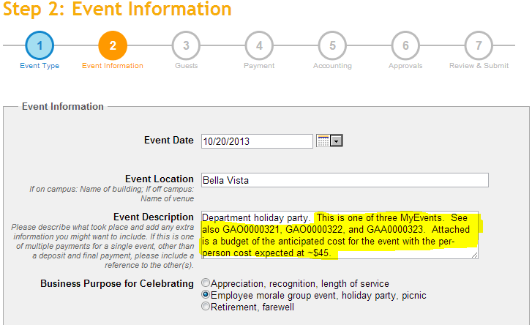
The Business Purpose
If more than one MyEvent is being processed for a single event, be sure to cross-reference the other event number(s).
When multiple MyEvents are required, also attach a ‘general’ budget so approvers can reasonably determine the anticipated per-person meal expense.
Please be careful with those acronyms!

Slide 22
The Business Purpose
Solid event description | Weak description
Monthly fund manager meeting to discuss actuals against budget and year-end forecasting. | Monthly fund manager meeting
Hosted dinner with guest speaker to discuss student feedback and industry trends focused on the course. OR Hosted dinner with guest speaker prior to presentation to discuss logistics. OR Hosted dinner with guest speaker to discuss participant feedback to presentation. | Hosted dinner with guest speaker
Monthly Coleman lab meeting to discuss research findings from X and Y projects and to review Smith’s presentation. | Monthly Coleman lab
Agenda may be attached to document business purpose

Slide 23
The Business Purpose
Spouses in attendance
Donor activities
Recruiting – if the spouse of the candidate is in attendance, invitation needs to reflect that UCSD is hosting the event
If UCSD did not pay the expense of a spouse in attendance, you can select “No” for Did a spouse/partner attend the event?
When the spouse works at UCSD
Role is considered “employee” when attendance is that of an employee
Exceeding the Per-Person Maximum Cost
The request must document the circumstances which were unavoidable or necessary to accomplish the University business purpose

Slide 24
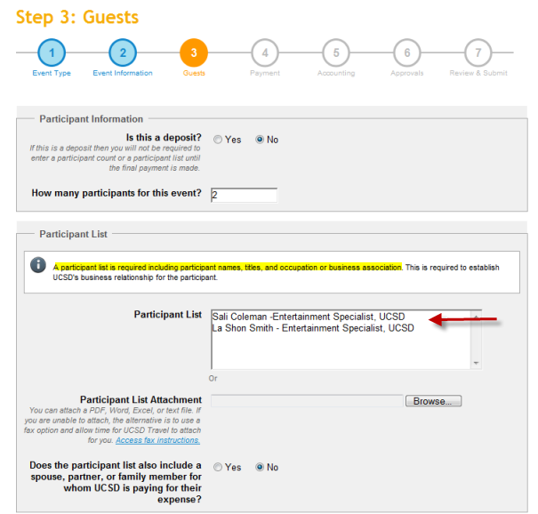
Describing the Participants
For multiple participants, you can upload a sign-in sheet, Excel file, etc.
REMINDER: Be sure to include the title and company affiliation.
Ex: Nancy Herbst, Travel Manager, UCSD
Research subjects can include first name and last initial
Ex: Nancy H, Research Subject

Slide 25
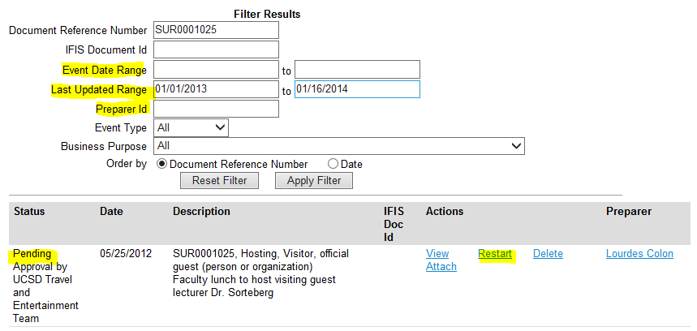
Checking the Status
Recent enhancements include
Last Updated Range
Preparer ID
The system no longer changes the date of the event to today’s date when restarted.
If corrections need to be made, the Restart option is the only way to make the edit.

Slide 26
Approval Considerations
Expenses should not exceed the per-person maximum for the meal type. The maximum includes tax and tip but not facility or room rental fees, which can be claimed as an additional expense. If expenses exceed the per-person maximum: It is considered special entertainment.
When the cost per person exceeds the maximum, provide a written justification as to why higher costs were unavoidable and necessary to achieve the UC San Diego business purpose of the entertainment.
While the per-person maximum may be exceeded on occasion, it might trigger a taxable event for both the host and the guests depending on the circumstances and frequency. See tax issues listed below.

Slide 27
Approval Considerations
Tax Issues
The IRS considers entertainment expenses as reportable income to the host under the following circumstances: Expenses are not substantiated with receipts (if for $75 or greater, or special entertainment in any amount).
The expenses are lavish or extravagant for the type of function.
The entertainment or travel is not directly related to the employee's job or otherwise qualifies as a UC San Diego business expense.
The official host (or other designated employee) is not present when the activity takes place.
This is why the “purpose” is so important and why there has been some “refining” of procedures for visiting scholars, students, individual types, etc.

Slide 28
Special Considerations
Hosting at a private residence
Contact Diana Olson, General Liability Manager
Consider the amount of personal risk the host will need to accept
Invitation needs to reflect that UCSD is hosting the event

Slide 29
Special Considerations
Attending community events and fundraisers
Receipt must break out the “meal” from the “donation”
If the individual pays directly, then s/he can only be reimbursed the amount of the “meal”
If paying by Travel Card, the payment must be sent with the transmittal memo and the receipt should reflect UCSD as the payee
Reimbursements to the Travel Card through MyTravel must include the transmittal letter and receipt (if available)
If paying by check, the transmittal letter must be uploaded in MyEvents

Slide 30
Special Considerations
Receipts
Expenses of $75 or more must be supported by ‘original’ itemized receipt
If the expense being claimed exceeds $75 but is comprised of two receipts, each less than $75, the receipts are required
Lost receipts need to include a description of what steps the host/department did to obtain a duplicate receipt and what is being done to avoid future lost receipts
If a credit card statement is being submitted when the receipt is lost, redact the credit card number, home address, and personal purchases

Slide 31
Updates

Slide 32
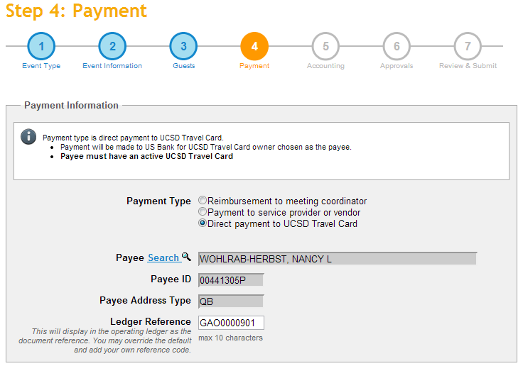
MyEvents & Travel Card
In operation since November. No more paper claims!

Slide 33
Catering Contracts
Don’t forget that catering vendors must have a contract signed by Procurement and Contracts (Robert Stueber) prior to the event and prior to submitting them through MyEvents for payment/ deposit.

Slide 34
Mileage Reimbursement Rate
 | 2013 | 2014
Mileage, general | 56.5¢/mile | 56¢/mile
Mileage for moves | 24¢/mile | 23.5¢/mile
MyTravel will automatically apply the new rates based on trip start date. Accordingly, mileage reimbursements that cover multiple years should be broken out into separate MyTravel claims.
The Mileage Reimbursement Rates page and Sample Mileage Log in BLINK has been updated to reflect the decreases with separate worksheets for each year.

Slide 35
Travel “Pre-”Reconciliation
Preparers can now add data and attachments to a trip in MyTravel prior to final reconciliation. For example, information on the cost of a conference registration can be entered and the receipt uploaded at the time the expense is incurred instead of waiting until the trip has been completed.

Slide 36
UCSD Travel is Paperless!
MyEvents
Payments to the Travel Card
MyTravel
Trips over one year – 100% audit and routed for Director’s approval
Travelers without direct deposit are encouraged to set up direct deposit

Slide 37
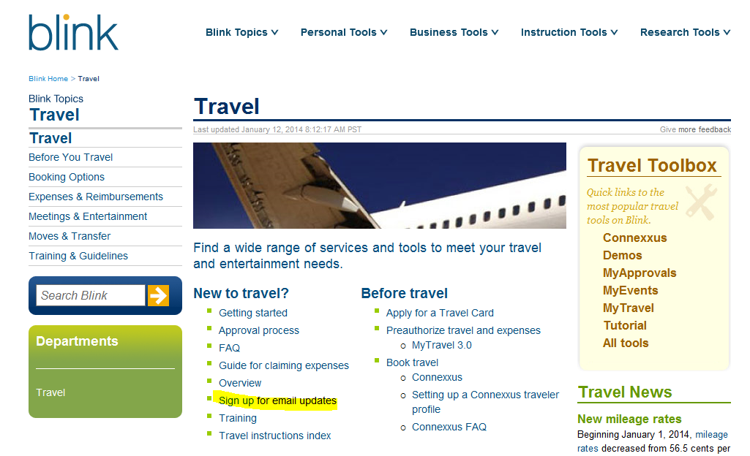
Stay Current

Slide 38
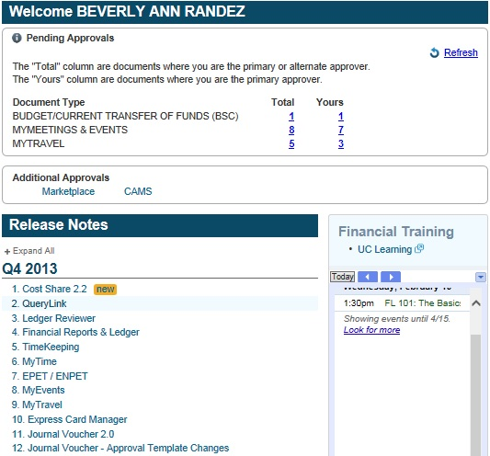
Stay Current

Slide 39
EVC Business Office Tools
Traveler Guidelines (one-sheet)
Travel worksheet (template)
Travel Transaction Preparer checklist
Meetings/Entertainment Transaction Preparer checklist
Guest List (template)

Slide 40
Express Card Attachment Tool

